Slide 1

The Admissions Pro
College Admissions Coaching
Kevin C. Jenkins
College Admissions Coach

Slide 2

Financial Aid Overview
Federal Government
  Grants
  Loans
  Federal Work Study
  State Government (if attending a school in Virginia)
Institution
  Merit
    Academic
    Athletic
    Artistic
  Need
    CSS Financial Aid Profile
Private Scholarships
  Businesses
  Civic organizations
  Foundations
  Private individuals

Slide 3

Cost of Attendance
Direct Costs
  Tuition
  Fees
  Room & board
Indirect Costs
  Books
  Travel expenses
  Other items
Net Price
  COA – Gift aid = Net Price

Slide 4

Federal Student Aid
FAFSA (Free Application for Federal Student Aid)
  Fafsa.ed.gov
  Opens October 1st of senior year
  Should be completed every year of college
FSAID
  Fsaid.ed.gov
  Replaces four-digit PIN as electronic signature
  Both student and parent are required to have FSAID (username & password)

Slide 5

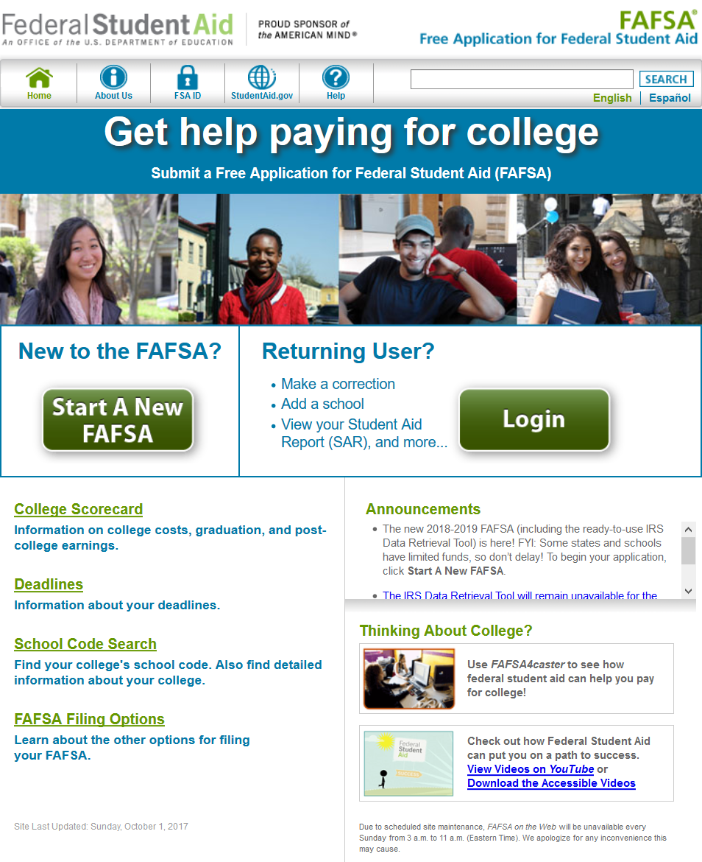
Free Application For Federal Student Aid
FAFSA Sections
  Student Demographics
    Selective service registration (males)
    Federal Work Study
  Dependency Status
    Independent if answering “yes” to any question
  School Selection
    Add up to ten schools
  Parent Demographics
  Financial Information (Student & Parent)
    “Prior, prior” taxes
    IRS data retrieval
    529 plans are reported as parent assets
    Retirement plans are not reported
  Sign & Submit
  Confirmation page
    EFC

Slide 6

Institutional Aid
Institutional Scholarships
  Merit-based scholarship
    Awarded by office of admissions
    Honors and service learning programs
  Need-based financial aid
    CSS Financial Aid Profile
    Used by 400+ (mostly private) colleges
    Administered by College Board
      $25 for first school $16 per additional (fee waivers available)
  Full need pledge

Slide 7






Private Scholarships
Private Scholarships
Search Strategy
  Major
    Teaching
    STEM
  Passions/interests
  Special circumstances
    Financial hardship
    First generation
    Underrepresentation
Requirements
  Essay
  Application
  Interview
Beware of…
  Asking for money or sensitive information
  Aggressive marketing
  Sweepstakes

Slide 8



Thank You!
Kevin C. Jenkins
College Admissions Coach
kcjenkins@theadmissionspro.com
540.498.0745
www.theadmissionspro.com

