Slide 1
Forest Park HS 10th Grade Parent Workshop SY 2022-23

Slide 2
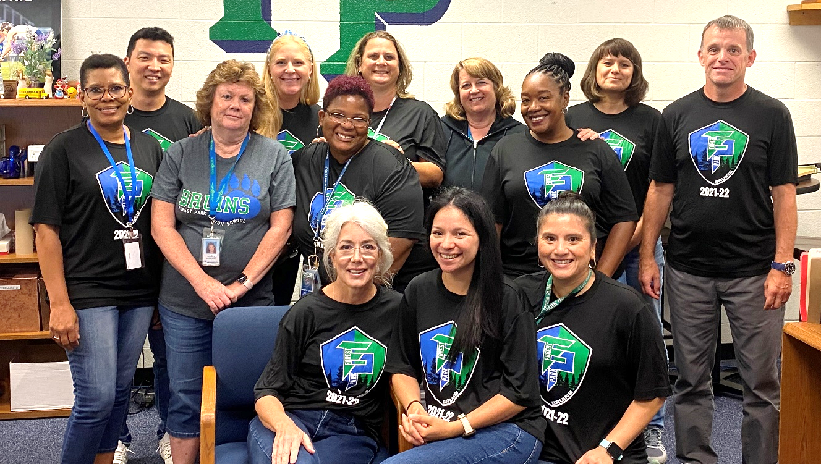
School Counseling Department
Mr. Smith Director of School Counseling | Ms. Boddie College/ Career Counselor | Ms. Linder A-Bo Thornton-Ulloa | Ms. Smith Br-Di Umana-Verneman | Ms. Flores Do-G Verrine-Wa | Ms. Scott H-Kop We-Williams | Mr. Miller Kor-Mor Wills-Yahya
Ms. Phalan Mos-Ren Yang-Z | Ms. Neace Reo-Thom | Ms. Scowcroft Registrar | Ms. Geisinger Secretary/ Transcripts | Ms. Wyatt Secretary/ Test Coordinator
Notes:
SS - counselors introduce themselves

Slide 3
How Students Access their School Counselor & 10th Grade Level Info
Students can make an appointment with their school counselor by accessing Bookings through the School Counseling canvas page.
In an emergency, students can be seen immediately by any school counselor, our school social worker, or school psychologist.
Grade level programs are uploaded onto our canvas page under the Academic button.
Notes:
AL

Slide 4
Confidentiality
Conversations are kept confidential unless someone
is being hurt or is involved in something illegal.
Confidentiality Statement:
“If you tell me that someone is hurting you or you intend to hurt yourself or someone else, or that you are involved in something illegal, I must tell someone.”
this includes suicide, pregnancy, abortion, communicable diseases, and alcohol/drug abuse
Notes:
AL

Slide 5
Diploma Types
Advanced
English 4 credits
Math 4 credits
Science 4 credits
Social Studies 4 credits
HPE I (CPR) & HPE II 2 credits
Econ & PF (Virtual) 1 credit
World Language 3 of 1 or 2 of 2
World Lang/Fine Art/CTE 1 credit
Electives (2 sequential) 2/3 credits
(CTE exam/adv course)
Total = 26 Credits
Standard
English 4 credits
Math 3 credits
Science 3 credits
Social Studies 3 credits
HPE (CPR) & HPE II 2 credits
Econ & PF (Virtual) 1 credit
World Lang/Fine Art/CTE 1 credit
Electives (2 sequential) 5 credits
(CTE exam/adv course)
Total = 22 Credits
5 SOLs
1 Math (Alg I, Geom or Alg II)
1 Science (E Sci, Bio or Chem)
1 Social Studies (WH I, WH II or US/VA)
2 English Reading & Writing (Eng 11)
Notes:
TSmith

Slide 6
Transcript & GPA
A transcript is an official record of a student’s classes, grades, and GPA.
To calculate a GPA:
Each grade earned is assigned a point value, for example, for standard classes:
A = 4 points B+ = 3.4 C+ = 2.4 D+ = 1.4 F = 0
B = 3.0 C = 2.0 D = 1.0
At the end of the school year, add the point values for all final grades and divide by the total number of classes taken
Note, certain courses are weighted (worth more points)
Example: an A in AP Psychology is worth 5 points, and
an A in Advanced Biology is worth 4.5 points
When a student repeats a course previously taken, both grades will be recorded on their transcript. Only the grade for the most recent attempt will be used in calculating the GPA.
Notes:
JF

Slide 7
Promotion Requirements
11th Grade - 11 credits; 6 in core courses
12th Grade - 16 credits; 9 in core courses
Notes:
TScott

Slide 8
Athletic Eligibility Requirements
Must pass 5 subjects by the end of the semester and year to be academically eligible for Virginia High School League (VHSL) activities
Must earn at least 3 D’s and 2 C’s every 9 weeks to remain eligible (Prince William County School Board regulation)
Notes:
TScott

Slide 9
Parent-Teacher Conferences
Forest Park High School encourages parents to communicate with teachers in a variety of ways.
All parents should use ParentVue to monitor grades, classroom assignments, find teacher email addresses, attendance, etc.
Parents may also request to receive a progress report from a teacher via email.
Prior to requesting a parent-teacher conference:
Check ParentVue for grades and/or missing assignments that may answer your question(s).
If your question is not answered through ParentVue, call (703-583-3200) or email the teacher(s) with whom you have a concern or question.
If, after a period of ongoing phone or email contact, you feel it is necessary to schedule a face-to-face meeting, you should contact the teacher directly to arrange a mutually convenient time to meet.
If you want to meet with three or more teachers, please contact your child’s School Counselor (571-589-3437) to setup. Conferences are held Monday through Thursday at 2:15 pm.
Counseling assignments are:
Aimee Linder A-Bo, Thornton-Ulloa
Tiffany Smith Br-Di, Umana-Verneman
Judith Flores Do-G, Verrine-Wa
Tera Scott H-Kop, We-Williams
Andrew Miller Kor-Mor, Wills-Yahya
Anna Phalan Mos-Ren, Yang-Z
Elisabeth Neace Reo-Thom
Notes:
AM

Slide 10
Grade Reporting Periods
First Quarter 44 Days 08/22 - 10/28
Second Quarter 47 Days 11/01 – 01/27
1st Semester 91 Days 08/22 - 01/27
Third Quarter 43 Days 01/31 - 03/31
Fourth Quarter 46 Days 04/11 – 06/15
2nd Semester 89 Days 01/31 - 06/15
Notes:
AP

Slide 11
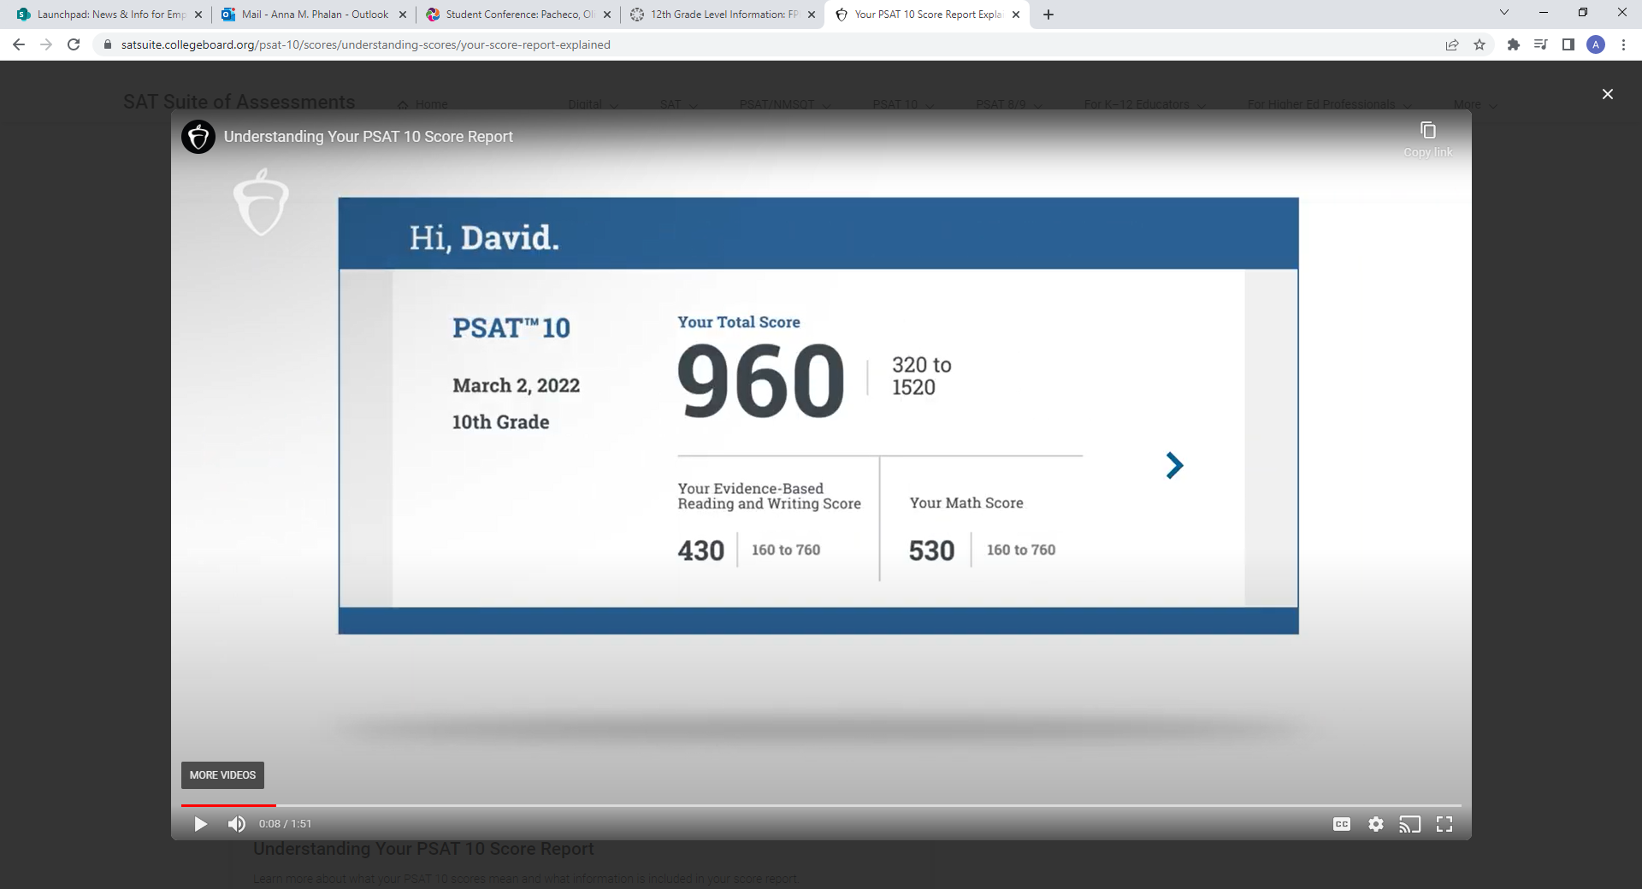
PSAT & Khan Academy
Counselors assisted 10th grader students setup and link their CollegeBoard and Khan Academy accounts. Khan Academy provides customized practice SAT tests in the areas students need to improve.
Juniors will take the PSAT again in October. Most students take their SAT in the Spring of their Junior year, then again in August or Fall of in their Senior year if needed.
Notes:
AP

Slide 12
AP Potential & DE Classes
Taking challenging classes is another way to prepare for college.
The AP Potential section of the student’s PSAT score report lists AP classes the student may be successful in.
Forest Park HS also offers DE (dual enrollment) classes through NOVA.
During scheduling, February 8th – 15th, students should let their Counselor know if they are interested in AP or DE classes.
The most popular AP/DE classes taken Junior year are:
AP Eng 11 or Eng 11 DE
AP US/VA History or US/VA History DE
**Note, the last day to make course request changes is June 15th, 2023**
Notes:
EN

Slide 13
Summer School
Students take summer school in order to get ahead, make room in their school year schedules or recover grades. Note, summer school is not free.
The county offers summer school, in-person or online. The links are below:
Summer School In-Person (at a different location each year):
https://www.pwcs.edu/academics___programs/summer_school/high_school_summer_school
Virtual Prince William Online:
https://virtualhs.pwcs.edu/registration_information/how_to_register/summer_registration
Notes:
EN

Slide 14
College and Career Planning Counseling Objective
Provide support, resources and experiences to prepare all FPHS students for post-secondary education and the workforce
Notes:
GB

Slide 15
Pop Quiz
True/False
The number one factor in college admissions is SAT/ACT score
Over 30 % of FPHS seniors will attend NOVA
Only students with an Advanced Diploma are successfully college-bound.
Most of the jobs predicted to have the highest growth in next 5-10 years will NOT require a 4-year degree.
Colleges are looking for "well-rounded" students.
By junior year, your student should have decided on a college major/career choice.
*What is the occupation predicted to have the highest growth rate in the next 5-10 year?
Notes:
GB

Slide 16
Truths
The most important factor in college admissions is rigor of courses and grades.
30% of the class of '22 reported going directly to NOVA after graduation; however, it is highly likely that closer to 40% ended up going.
Colleges do NOT distinguish between "types" of diplomas. They evaluate individual transcripts against the backdrop of what is offered at the student's high school.
Colleges are not looking for a "list" of activities. They want commitment, consistency, and contribution. They do want a "well-rounded" freshman class each year.
The fastest job growth in the next 5-8 years will be in Healthcare, Computer/mathematical (IT), and Personal Care.
The occupation with the most growth (43%) is Nurse Practioner
Notes:
GB

Slide 17
College and Career Readiness
Self Discovery, Career Exploration, College Investigation/research; Work based Learning Opportunities
Elective courses of interest
Maintain strong transcript
Involvement in extracurricular activities (in or out of school)
Internships/ Job shadowing/ part-time employment
Talk to adults about their jobs and career journey
Ongoing conversations about future goals
Notes:
GB

Slide 18
What 10th graders should be doing NOW
In Naviance, Exploring careers and completing:
Game Plan Survey
Career Interest Profile
Other:
Choosing electives relating to interests
Getting in the habit of reading email and counseling canvas announcements
Volunteering in an area of interest
Notes:
GB

Slide 19
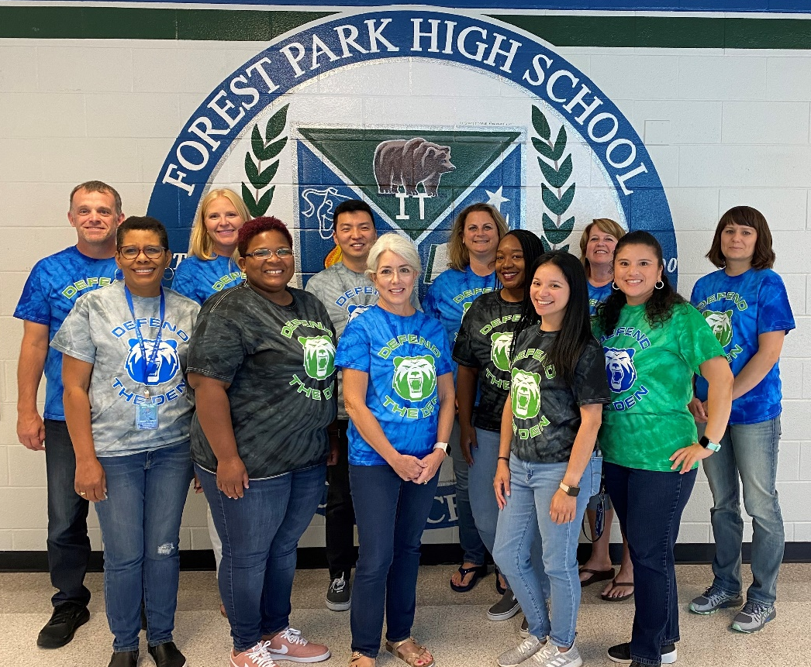
Thanks!
Q & A
School Counseling
Follow us on Twitter!
@fphscounseling
Your School Counseling Team
Notes:
SS

